Slide 1
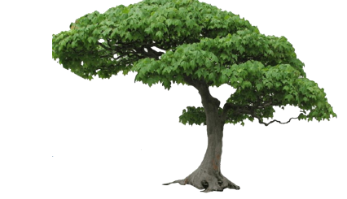
Decision tree

Slide 2
Definition
A schematic, tree-shaped diagram used to determine a course of action or show a statistical probability.
Each branch of the decision tree represents a possible decision, occurrence or reaction.
The tree is structured to show how and why one choice may lead to the next, with the use of the branches indicating each option is mutually exclusive.

Slide 3

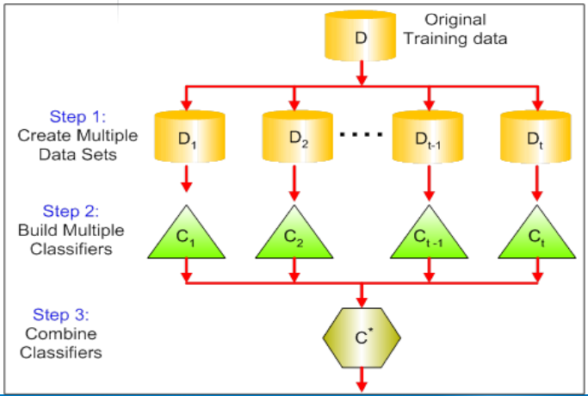
Decision tree vs Random forest
“Random forests are a combination of tree predictors such that each tree depends on the values of a random vector sampled independently and with the same distribution for all trees in the forest.”

Slide 4
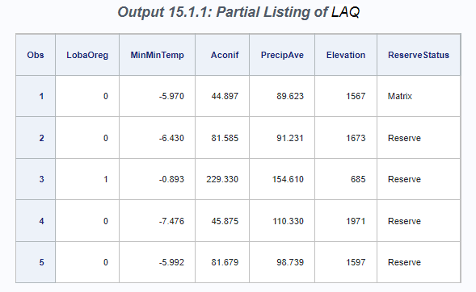
Table of data set
See first five observations
proc print data=sampsio.LAQ(obs=5);
var LobaOreg MinMinTemp Aconif PrecipAve Elevation ReserveStatus; run;
The LAQ data set consists of 30 measurements of environmental conditions, such as temperature, elevation, and moisture, at 840 sites.
These variables are treated as predictors for the response variable LobaOreg (our main object), which is coded as 1 if the lichen species Lobaria oregana was present at the site and 0 otherwise.

Slide 5
HPSPLIT procedure to create a classification tree for LobaOreg
GROW statement specifies the entropy criterion for splitting the observations during the process of recursive partitioning that results in a large initial tree
PRUNE statement requests cost-complexity pruning to select a smaller subtree that avoids overfitting the data.
Partition fraction statement decided to divide data into trainset and test set.
‘VALIDATE =0.3’ means that train set is 70% and test set is 30%
Seed is a parameter for random selection.
In the case of binary outcomes, the EVENT= option is used to explicitly control the level of the response variable that represents the event of interest for computing the area under the curve (AUC), sensitivity, specificity, and values of the receiver operating characteristic (ROC) curves.
Note: These fit statistics do not apply to categorical response variables that have more than two levels, so the EVENT= option does not apply in that situation. Likewise, this option does not apply to continuous response variables.
ods graphics on;
proc hpsplit data=sampsio.LAQ;
class LobaOreg ReserveStatus;
model LobaOreg (event='1') =
Aconif DegreeDays TransAspect Slope Elevation PctBroadLeafCov
PctConifCov PctVegCov TreeBiomass EvapoTransAve EvapoTransDiff
MoistIndexAve MoistIndexDiff PrecipAve PrecipDiff RelHumidAve
RelHumidDiff PotGlobRadAve PotGlobRadDiff AveTempAve AveTempDiff
DayTempAve DayTempDiff MinMinTemp MaxMaxTemp AmbVapPressAve
AmbVapPressDiff SatVapPressAve SatVapPressDiff ReserveStatus;
grow entropy;
partition fraction(VALIDATE = 0.3, SEED =123)
prune costcomplexity;
output out = scored;
run;

Slide 6
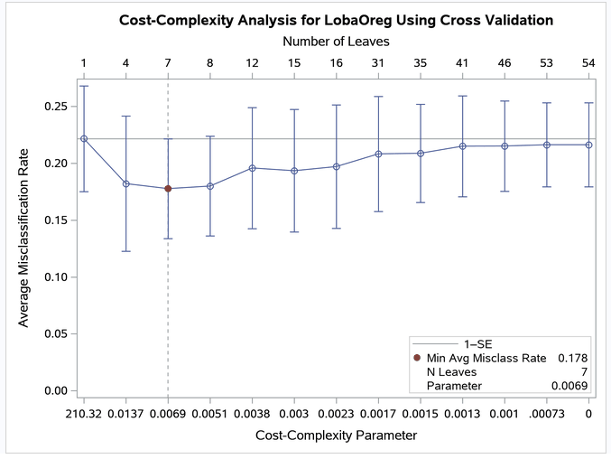

Misclassification Rate (error rate) as a Function of Cost-Complexity Parameter
Definition
전체 값에서 오차의 값이 발생한 비율
모형이 제대로 예측하지 못한 관측치를 평가하는 지표
Misclassification rate는 전체 관측치 중 실제 값과 예측 치가 다른 정도를 나타내며 1-accuracy 또는 다음과 같은 식으로 나타낸다.
Selects the smallest subtree for which the misclassification rate is less than the minimum rate plus one standard error. >> Minimum error rate is at 7 leaves, so select subtree with six leaves.

Slide 7
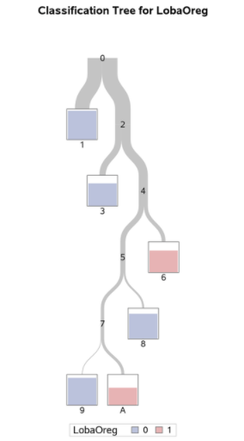
Overview of Fitted Tree
The color of the bar in each leaf node indicates the most frequent level of LobaOreg and represents the classification level assigned to all observations in that node.
The height of the bar indicates the proportion of observations (sites) in the node that have the most frequent level.
Note: there is impurity in each leaf node. In other words, there can be LobaOreg observation values 1 and 0 in each node.

Slide 8
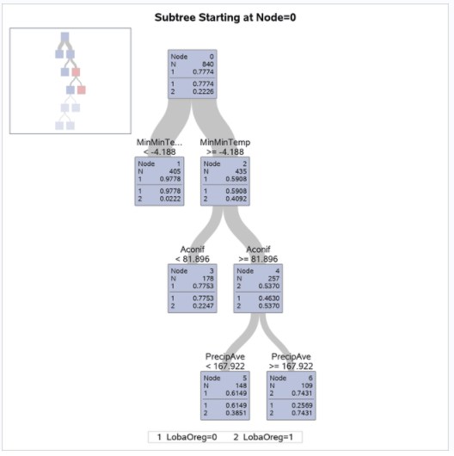
First Four Levels of Fitted Tree
The diagram provides more detail about the nodes and splits in the first four levels of the tree. It reveals a model that is highly interpretable.
The 435 sites for which MinMinTemp –4.188 (node 2) are further subdivided based on the variable Aconif, which is the average age of the dominant conifer at the site. Lobaria oregana is present at 53.7% of the 257 sites for which MinMinTemp –4.188 and Aconif 81.896 years.

Slide 9
The 257 sites for which Aconif 81.896 are further subdivided on the basis of PrecipAve (average monthly precipitation) with a cutoff value 167.922 mm.
Lobaria oregana was present at 74.31% of the 109 sites for which MinMinTemp –4.188, Aconif 81.896 years, and PrecipAve 167.922 mm.
Contrast this occupancy percentage with the 2.22% for the sites for which MinMinTemp –4.188.
In summary, based on the first three splits, Lobaria oregana is most likely to be found at sites for which MinMinTemp –4.188, Aconif 81.896, and PrecipAve 167.922.

Slide 10
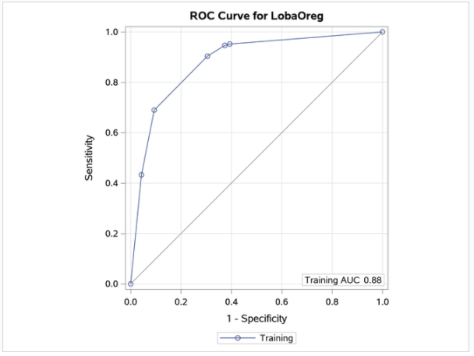
ROC Curve for Classification
The AUC statistic and the values of the ROC curve are computed from the training data. When you specify a validation data set by using the PARTITION statement, the plot displays an additional ROC curve and AUC statistic, whose values are computed from the validation data.
Note: In this example, the computations of the sensitivity, specificity, AUC, and values of the ROC curve depend on defining LobaOreg=1 as the event of interest by using the EVENT= option in the MODEL statement.
진단의 관점에서 민감도(sensitivity)는 질병이 있는 사람을 얼마나 잘 찾아 내는가에 대한 값이고 특이도(specificity)는 정상을 얼마나 잘 찾아 내는가에 대한 값이다.

Slide 11
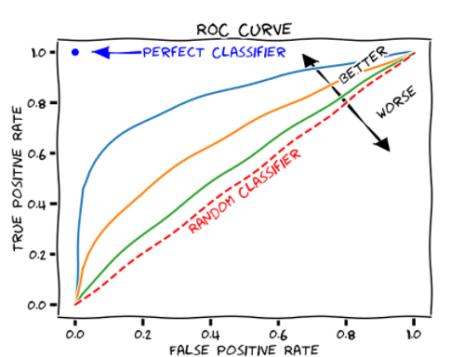
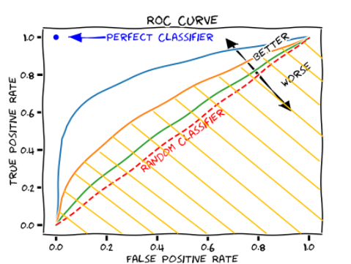
ROC curve interpretation
The colored area is AUC (정확성 지표)

Slide 12
Reference
https://documentation.sas.com/doc/ko/pgmsascdc/9.4_3.4/stathpug/stathpug_hpsplit_examples01.htm
https://m.blog.naver.com/sharp_kiss/221826800044
https://codedragon.tistory.com/9618
https://www.sas.com/content/dam/SAS/en_ca/User%20Group%20Presentations/Toronto-Data-Mining-Forum/dzieciolowski-randomforests.pdf
https://towardsdatascience.com/how-to-find-decision-tree-depth-via-cross-validation-2bf143f0f3d6

Slide 16
Random forest process

Slide 17
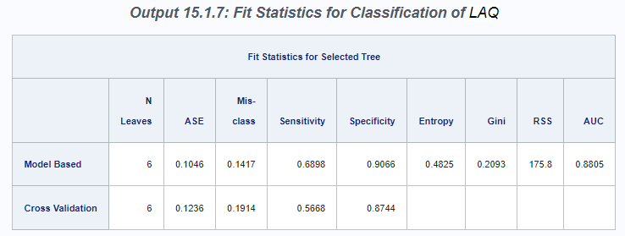
The model-based misclassification rate is low (14.2%), but the corresponding sensitivity, which measures the prediction accuracy at sites where the species is present, is only 69%.
Good overall prediction accuracy but poor prediction of a particular level can occur when the data are not well balanced

Slide 18
fit statistics for the selected classification tree.
Two sets of fit statistics are provided. The first is based on the fitted model, and the second (requested by the CVMODELFIT option) is based on 10-fold cross validation.

Slide 19
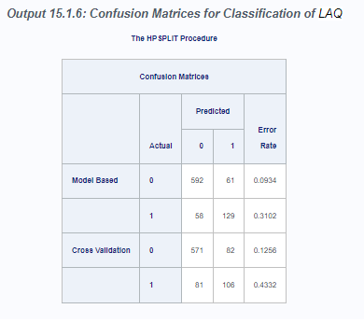
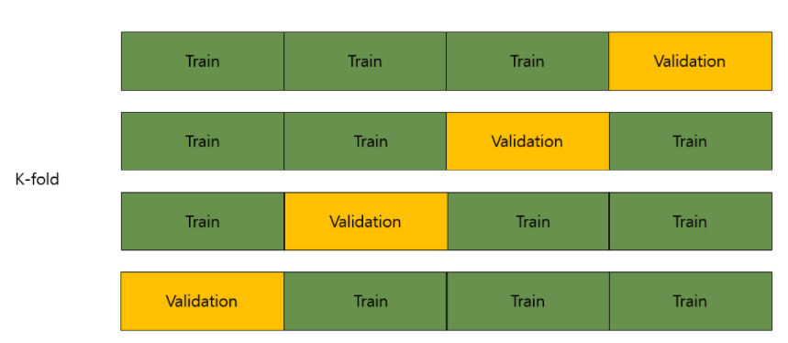
The ‘accuracy ‘ of the selected classification tree
The cross validation confusion matrix is produced when you specify the CVMODELFIT option. It is based on a 10-fold cross validation that is done independently of the 10-fold cross validation that is used to estimate ASEs for pruning parameters.
K-겹 교차 검증(K-fold Cross Validation)은 가지고 있는 데이터를 K개의 그룹으로 나누어 그 그룹 중에서 하나를 추출하여 validation set으로 사용하는 것입니다. 그리고 이 과정을 K번 반복하여 나온 결과값을 평균내어 검증 결과 값으로 사용합니다.

Slide 22
Training vs validation
Cross validation

